Slide 1

Taxi Project
New York Taxi Trips

Slide 2
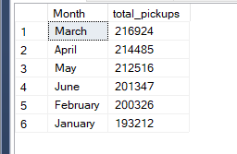
Number of Pickups on each month of 2016
Here, we can see most pickups are taken on March.

Slide 3
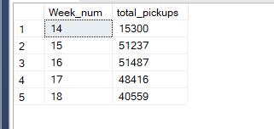
What is the best performing week of April in terms of number of pickups?
Most pickups are taken on week 16 (April 18 – April 24).

Slide 4
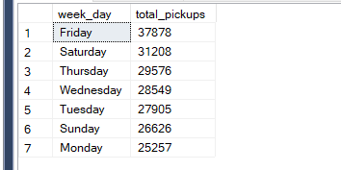
What is the best performing day of week in terms of numbers of pickups?
We can see most trips were taken on Friday, by contrast Monday being the least.

Slide 5
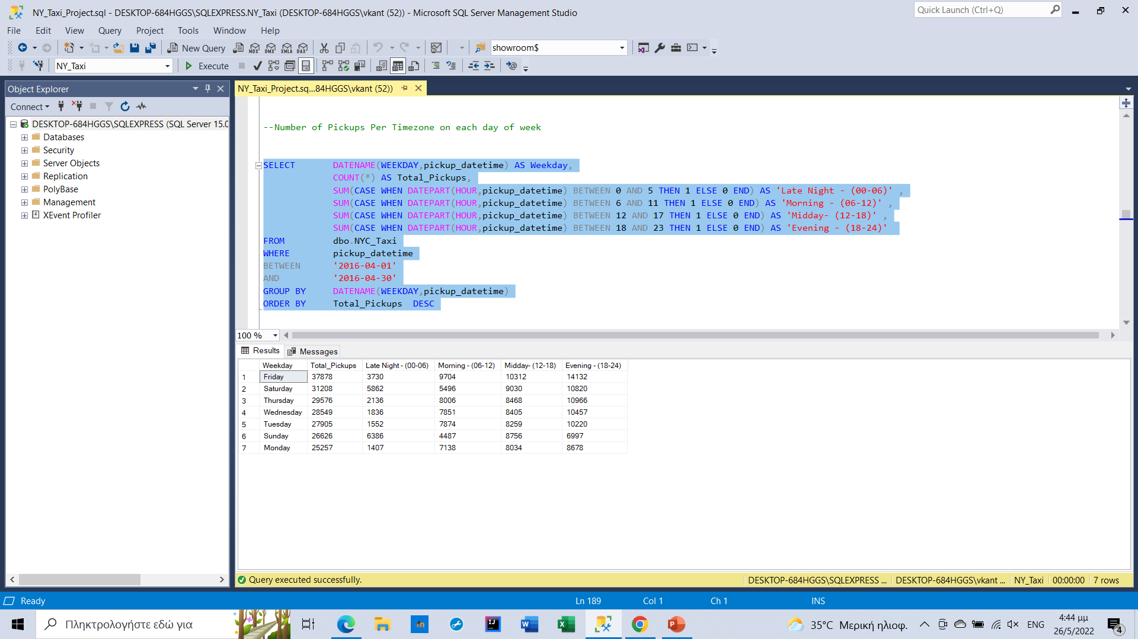
Pickups per hours of the day
We point out that most pickups were taken in the evening.

Slide 6
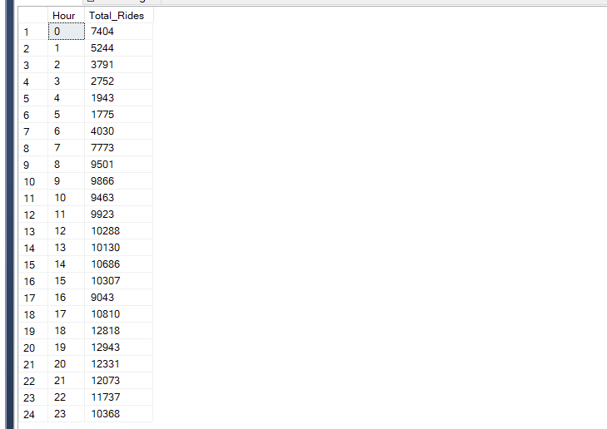
Number of pickups per hour
Observing the numbers, we can assume that most rides were taken at 7 PM.

Slide 7
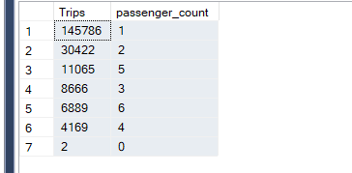
Relationship between passengers and trips
Most trips consist of one or two customers. The instance of large group of people traveling together is rare.

Slide 8
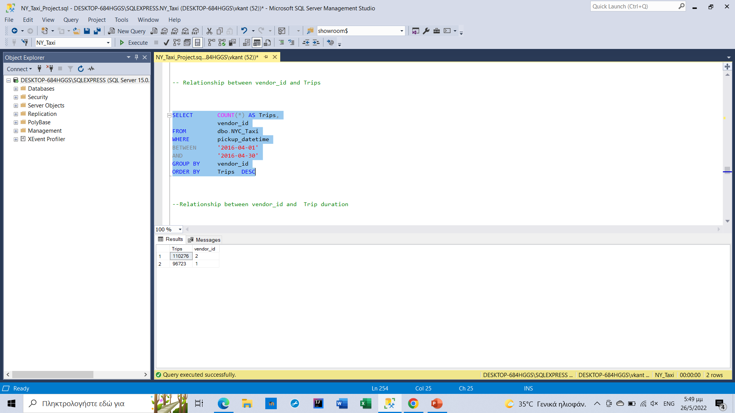
Relationship between vendor id and trips
The majority of customers use vendor id 2.

Slide 9
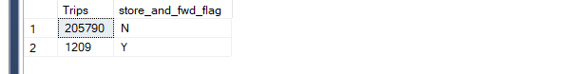
Relationship between store forward flag and trips
The number of N flag is much larger.

Slide 10
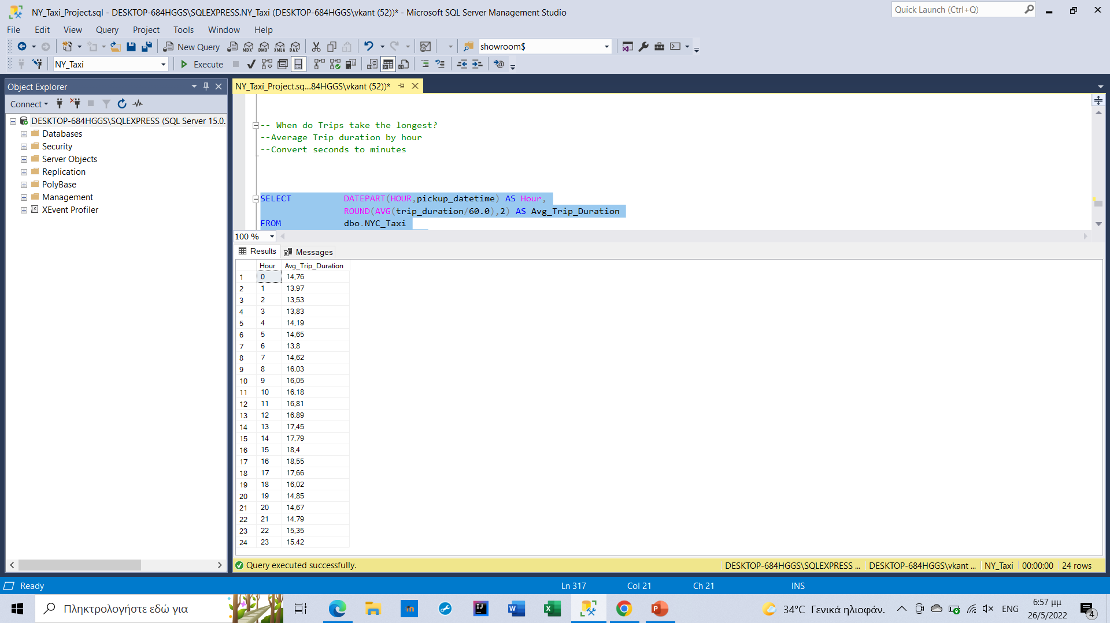
When do trips take the longest?
As we can see, 4 PM hour has the highest trip duration of 18.55 minutes. As we would expect trip durations are shortest at late night due to less traffic.

Slide 11
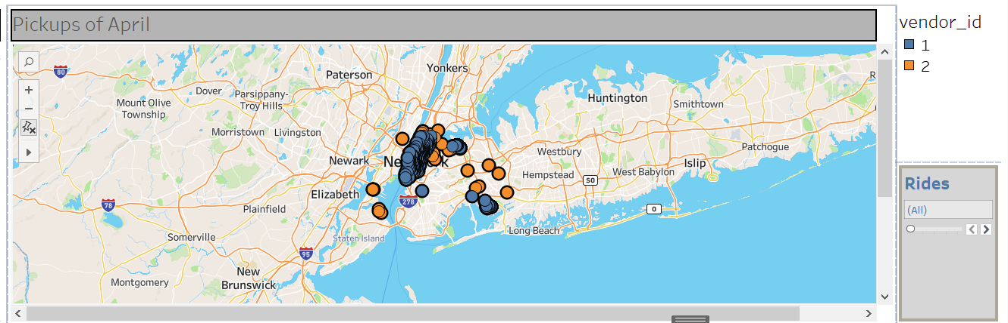
What are the most popular pickup points, with minimum number of rides being 2?
In accordance with the map, we can assume that the most popular pickup points are in Manhattan, JFK Airport and LaGuardia Airport.

Slide 12
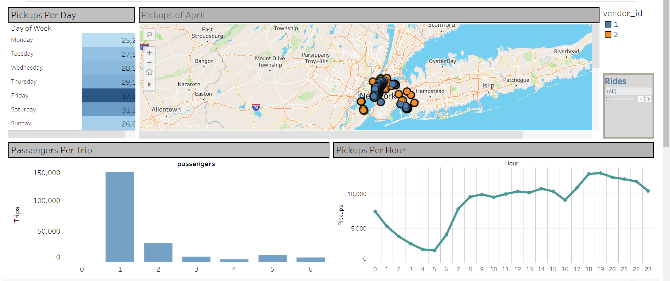
Tableau Dashboard

